Slide 1
“Iit HELPDESK”
Command line multi clients chatroom software

Slide 2
Introduction:
This is a multi client command line chatroom. Where users can chat with each other or specific user in real time over network. It helps to transfer information and file within a second, where data is encrypted for security purposes.

Slide 3
Overview of the problem statement:
Simultaneous Connections: The chatroom support multiple clients connecting to the server at the same time. Each client will be able to send and receive messages independently. Also, they can send private messages.
Real-Time Communication: The chatroom provide real-time communication between clients, allowing them to exchange messages instantly without any significant delays.
Scalability: The chatroom is designed to handle a few number of concurrent users whose are stay over same networks(Lan connection, same wifi).
Message Broadcasting: Messages sent by a client should be broadcasted to all connected clients or specific clients in the chatroom. This ensures that all participants or individual participant can receive the messages and can actively participate in the conversation.
Cross-Platform Compatibility: The chatroom is accessible from different desktop computers, laptops.
User Interface: The chatroom will run over command line as a result, it is easy to run also user-friendly interface that allows clients to easily join, send messages, view received messages.

Slide 4
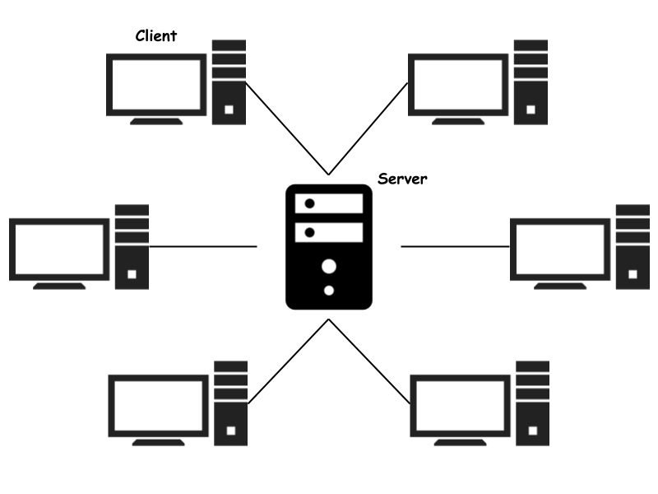
Features:
Authentication System
Messaging
Group message
Private message
File sharing
Specific client
End to end encryption
Stakeholders:
Students
Teachers

Slide 5
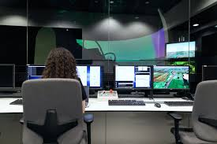
Objectives:
Lightweight and fast
Saving time
Develop learning & supporting skills
Faster communication
Data Secure

Slide 6

Challenges:
Set up real time communication network
Implementation of algorithm
File handling
Completing within proposed time

Slide 7
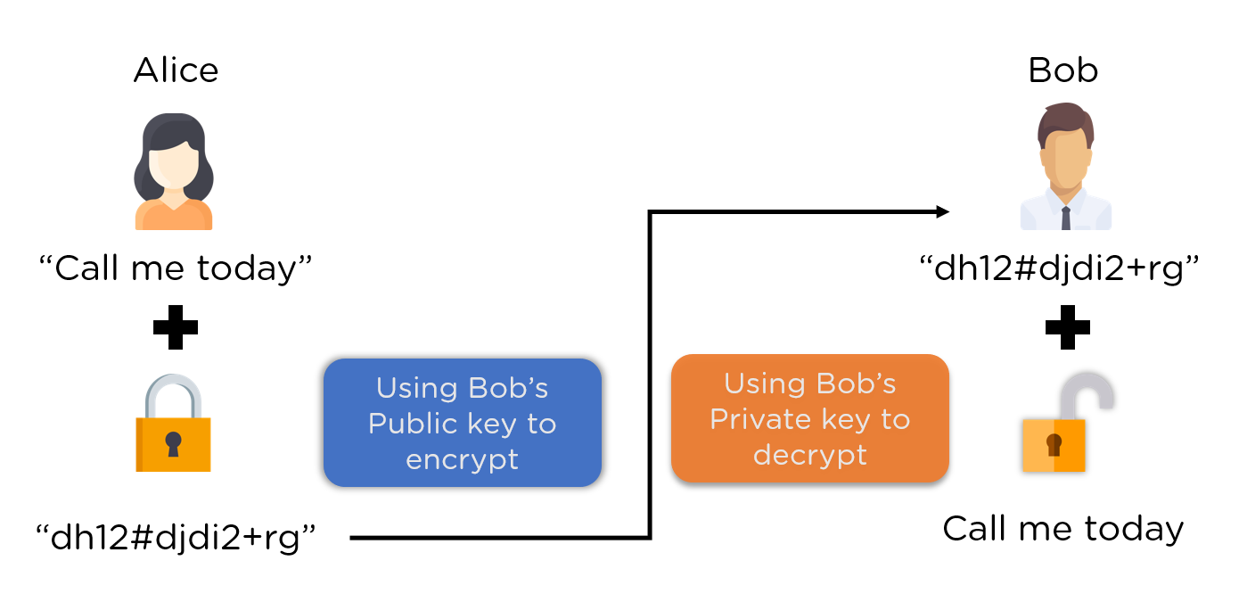
Technical Details:
Language: Java
Tools: IntelliJ IDEA
Algorithm: RSA Algorithm(encryption and decryption)
Algorithm visualize

Slide 8
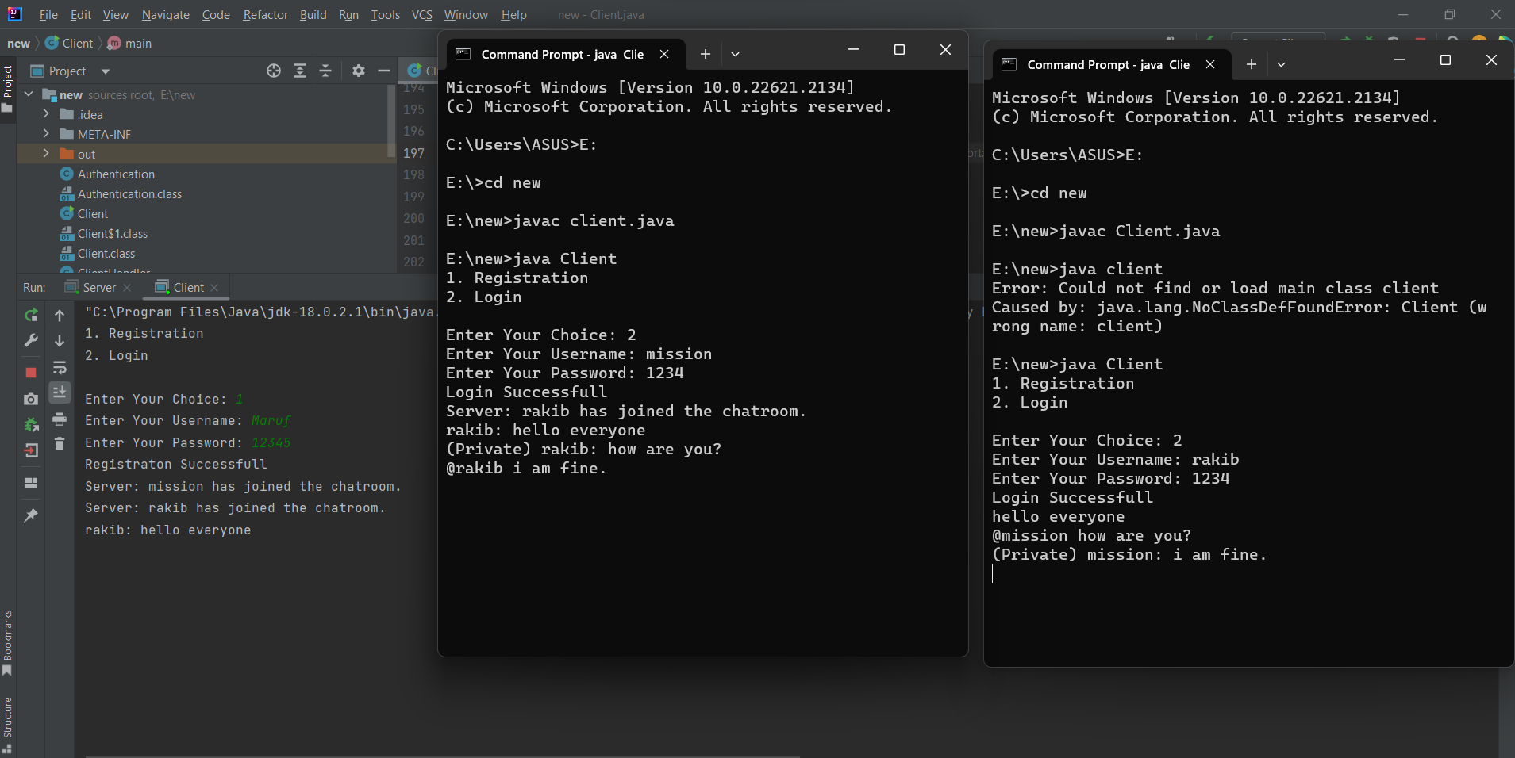
Snapshot of output:

Slide 9

ANY
QUESTIONS ?

Slide 10
~Thank You~

